Slide 1
Nyc doh ratings
Group 7: Emma Pang, jenny yi, Lauren McKinzie, Regana Alicka, Steve Li

Slide 2
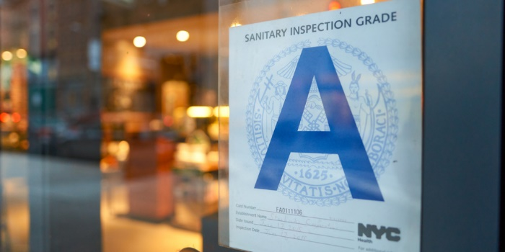
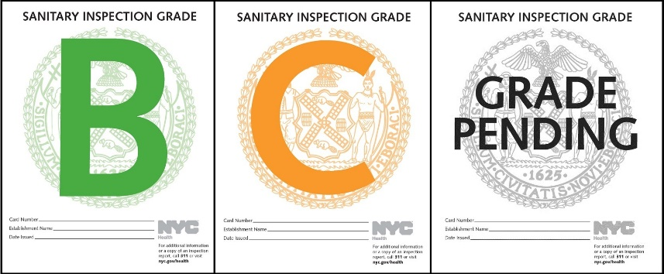
RESEARCH APPROACH
CONTEXT
The Department of Heath (DOH) is responsible for conducting restaurant health inspections on all food-handling, food-service establishments in NYC.
A restaurant’s score corresponds to a letter grade. The lower the score AKA the less violation points, the better the grade.
OBJECTIVES
Using the DOH’s public data on restaurant violations and grades, we were able to answer:
How many restaurants have A, B, C ratings? And where are they?
Is there a specific area in NYC with a higher concentration of a rating?

Slide 3

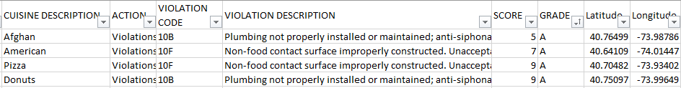

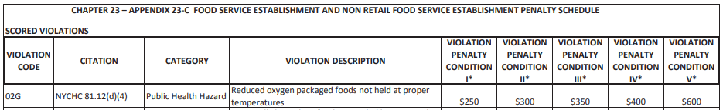
Data sources
1. March 2020 NYC Restaurant Inspection Results ~430K Rows
2. DOH Violation Penalty Dictionary
Notes:
Those >50YO are more likely to dislike rigid fabric and wide leg.

Slide 4
Data ETL
Because the data set was so large (167 MB), we only extracted the data points we needed. We also categorized the violation codes into more manageable buckets (food storage related, facility related, vermin related, etc.) and added violation penalty feeds based on the DOH violation dictionary.
(Add snap shots of new data here)

Slide 5
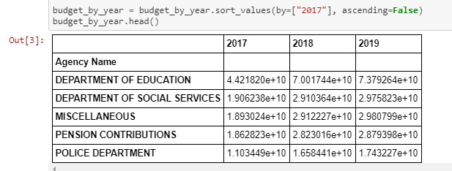
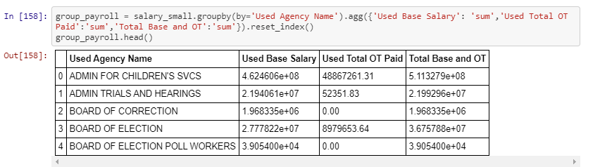
Data exploration
Once we were able to get our dataset together, we….mongo

Slide 6
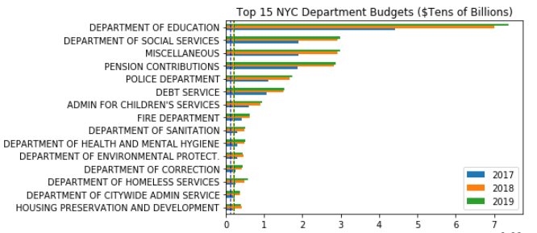
Top 15 nyc agency budgets
The Dept. Of Education has the largest budget in NYC by far. It is the largest school system in the entire country, spanning across Pre-K to 12th grade, public and charter schools, and special education programs to provide education, extracurricular activities, transportation, health services, food services, and more. We were surprised to not see the Dept. of Transportation Top 15 budgets but found out that agency is actually under the State of NY, not City funding.

Slide 7
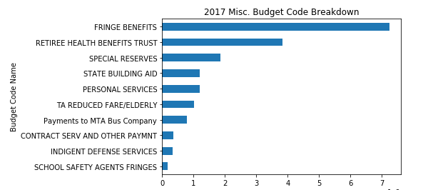
Top 15 nyc agency budgets – Misc.
Like any balance sheet, NYC agencies have a catch-all “miscellaneous” bucket to place any non-department specific costs into and avoid going over-budget within their department. This city-wide bucket is the 3rd largest budget we saw. Breaking down the 2017 miscellaneous budget, we saw that most of the funds were fringe benefits.
Fringe Benefits are any type of non-salary income like medical insurance, vacation pay, meals, tuition reimbursement, etc.

Slide 8
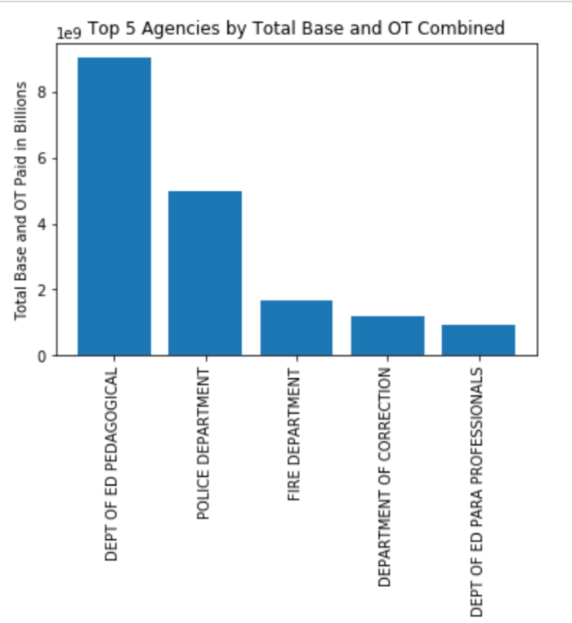
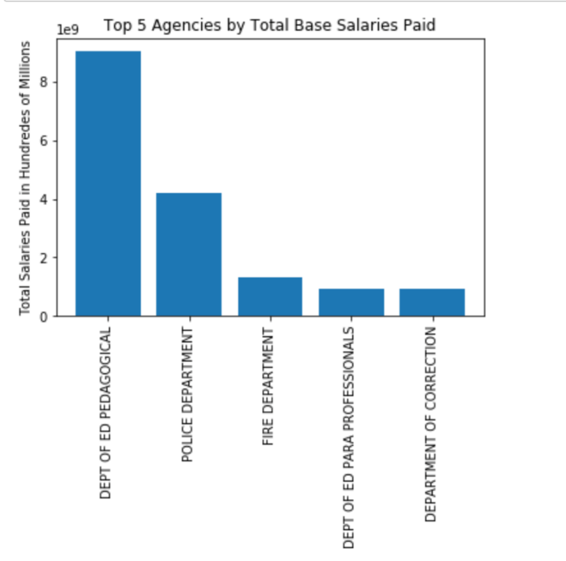
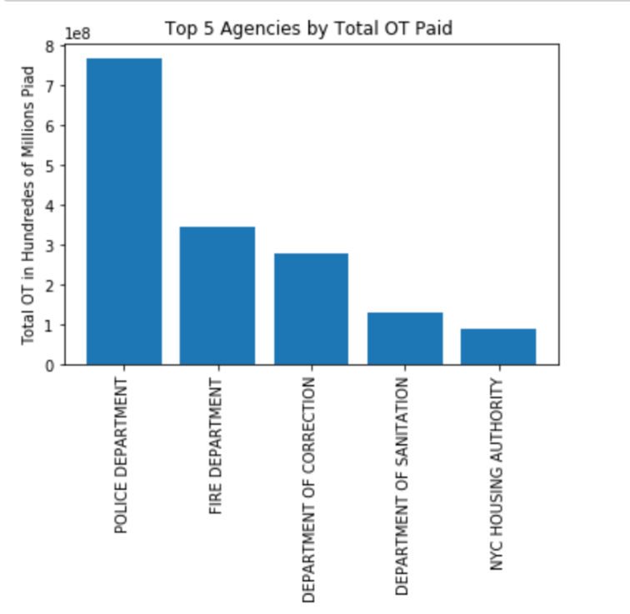
Top 5 spend on total, base, overtime salary
Among the top 5 agencies with the largest total salaries, two are part of the department of education and the other 3 are the police dept., fire dept., and dept. of corrections. When looking solely at overtime pay, the police dept., fire dept., and dept. of corrections jump up to the top 3 agency slots.

Slide 9
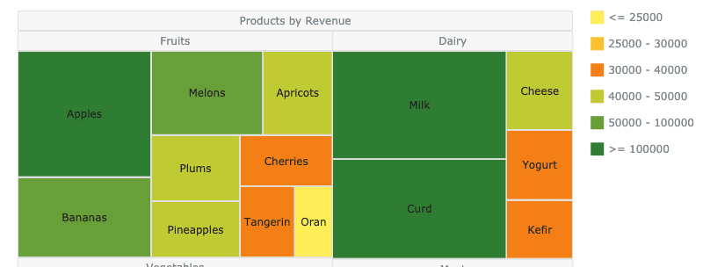
Post mortem – WOULD’VE, COULD’VE, SHOULD’VE
WOULD’VE
If we had more time, we would have looked into the additional “Total Other Pay” column in the Payroll data file and we would have done some cooler charts like this one:
COULD’VE
We could’ve looked at gender salary gaps if gender was available it the payroll data. We could’ve looked at base salary differences across agencies for the same role. (e.g. how much does a data analyst make at one agency vs. another?)
SHOULD’VE
We should’ve cleaned the data more because within the >3.3million rows there were some hourly wage employees included in base salary but we’re confident this subset would not have significantly impacted the results.

Slide 10
Questions?

Slide 11
Thank you!

